Slide 1
Predict Password Strength Classifier Using NLP
Presented By: Jerrina Ann Simon

Slide 2
INTRODUCTION
Passwords are used for many purposes such as logging into accounts, logging into email accounts, transferring funds, etc.
Strong Passwords are crucial for protecting sensitive information.
In this project, aim to use NLP and machine learning model to predict and assess the strength of passwords.

Slide 3
NLP
NLP is a branch of artificial intelligence that focuses on the interaction between computers and human language.
Enable computers to understand, interpret, and generate human language in a meaningful way.
NLP analyses textual patterns in passwords, thus helping the computer to see the patterns and extract the features
The project focuses on using NLP for strength assessment.

Slide 4
OBJECTIVE
Developed a model to predict password strength based on weak, medium, and strong which is labeled as 0,1,2.
The model is developed using Natural language Process (NLP) techniques.

Slide 5
Methodology
Data collection:
Loads a dataset from a CSV file containing 'password' and 'strength' columns.
Initially the dataset has 66,000 values.
It then samples a specified number of rows to 10,000 for analysis.
Data preprocessing:
checks for missing values, and removes missing values.
Converts the 'strength' column to numeric formats.
converts all the passwords to lowercase, and removes special characters from them.
Feature Engineering:
Adding features based on the password characteristics.
Includes password length, digits, and uppercase lowercase letters.

Slide 6
Split the dataset:
The dataset is divided into features (X) and the target variable (y). Features include password-
related information and derived features.
The data is further split into training and testing sets using the train_test_split function from
scikit-learn.
TF-IDF Vectorization:
Import TfidfVectorizer from sci-kit-learn
TF-IDF (Term Frequency-Inverse Document Frequency) vectorization is applied to convert the textual password data into numerical features.
The TfidfVectorizer is configured to analyze characters (analyzer='char') and consider n-grams of
lengths 1 to 3 (ngram_range=(1, 3)).
Model Training:
A Random Forest classifier is chosen as the machine learning model.
Random Forest is an ensemble learning method that combines multiple decision trees to make more accurate and robust predictions.
The model is trained on the training set (X_train, y_train) using the fit method.

Slide 7
Deployment
Creates a streamlit web application with a title and a box for the user to enter the passwords.
Once the user enters the password, it preprocesses and extracts features from the input password.
The code calculates the accuracy of the model by comparing its predictions on the test set (X_test) with the actual labels (y_test).
The accuracy score is a measure of how well the model performs on unseen data.

Slide 8
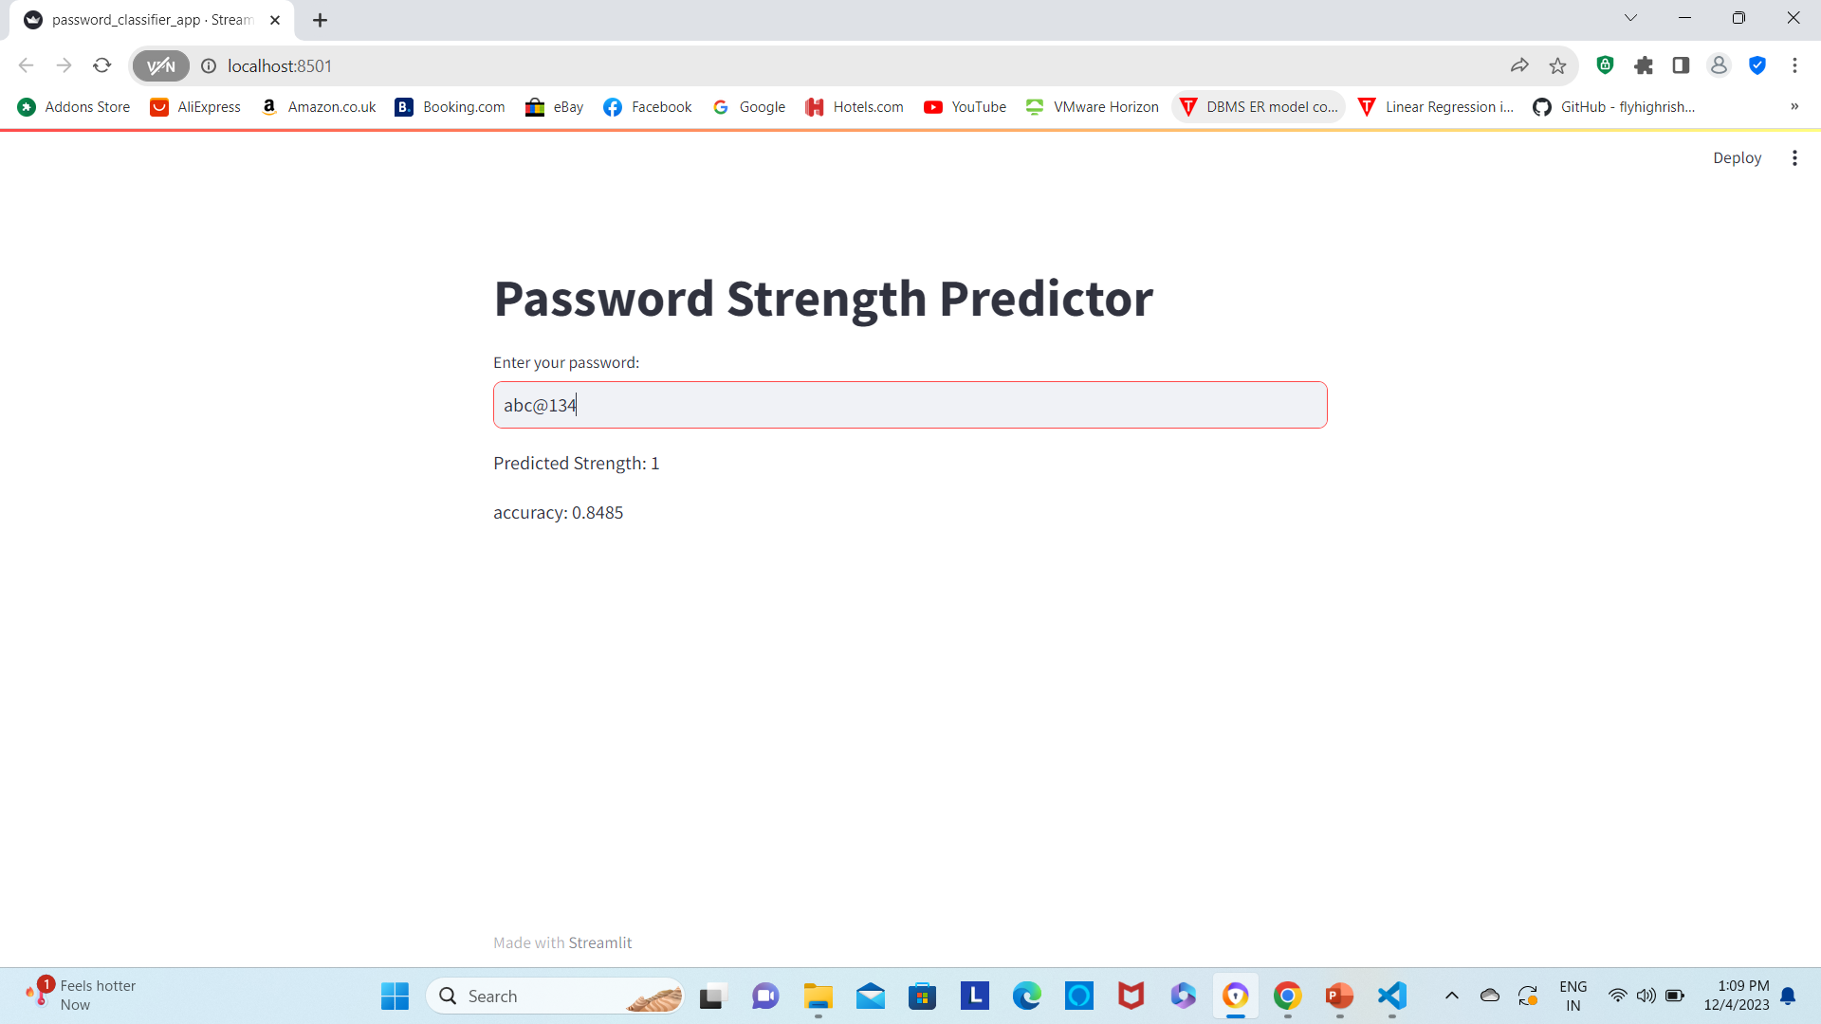
Output

Slide 9
Thank You

